Slide 1
OPIM 5604–B13 Predictive Modeling Group Project November 29, 2017
Email Spam Classification
Animesh Choudhary
Arjun Periyasamy
Elisa Polci
Subhashree Srinivasan

Slide 2

Purpose
To develop a classification model to identify an email as spam or not where spam is defined as an unsolicited commercial email.
A key objective is to minimize misclassification of valid emails as spam.
Notes:
project purpose- relate to widespread business problem

Slide 3
Topics
Overview of the analytics processes, tools and techniques
Data Collection
Data Pre-processing
Data Modeling
Model selection
Key findings and recommendations
Q & A
Notes:
SEMMA methodology

Slide 4
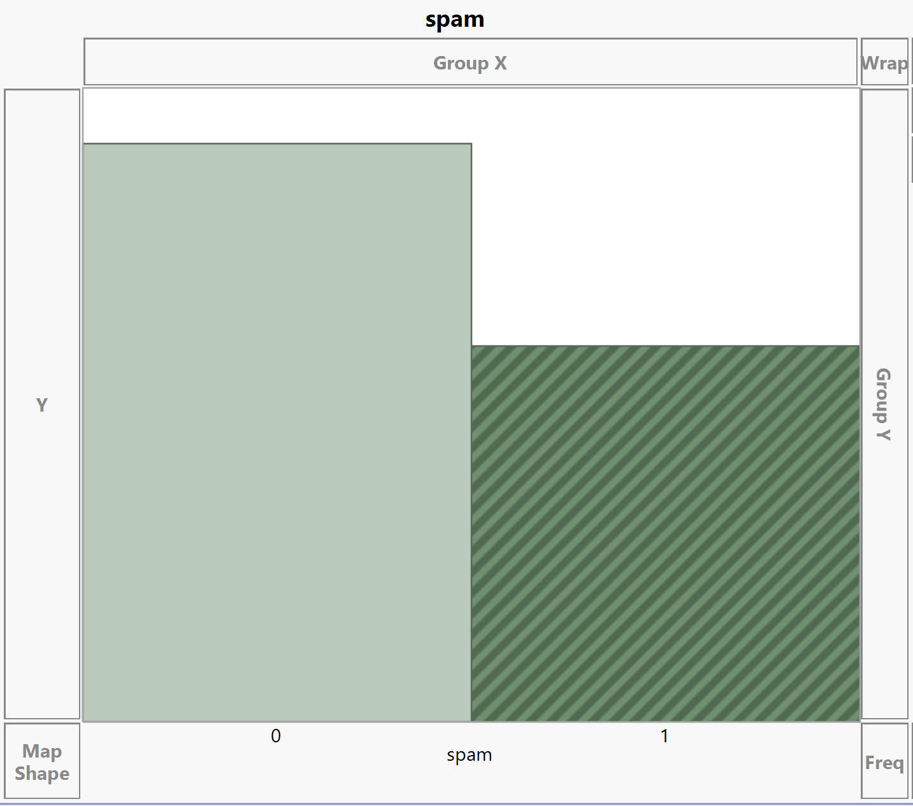
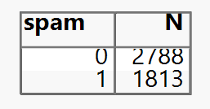
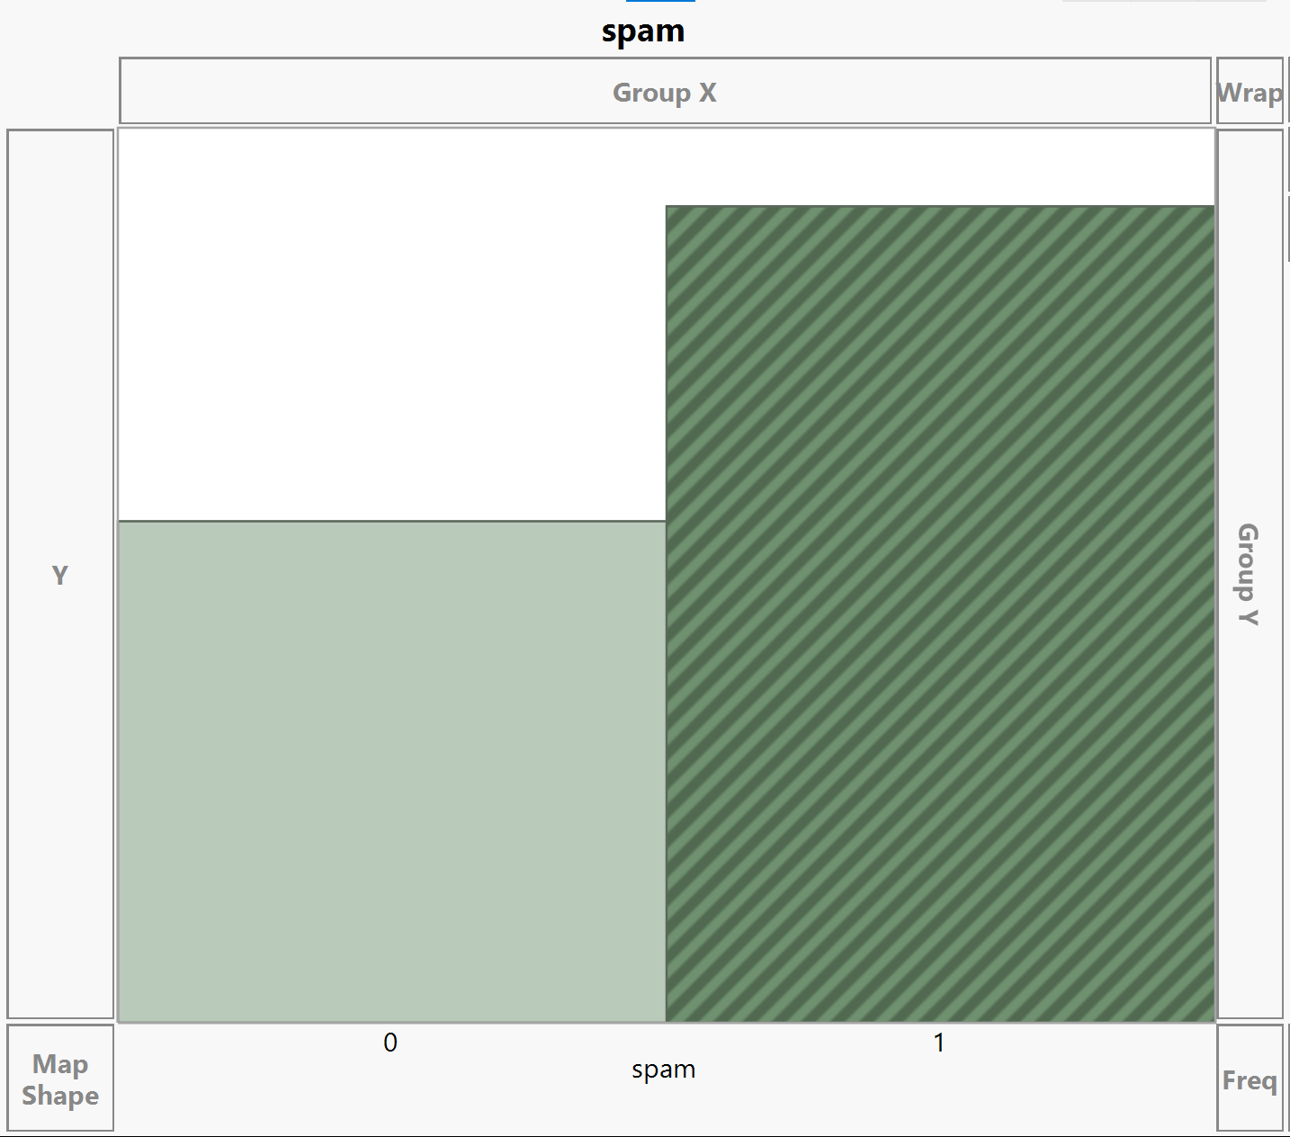
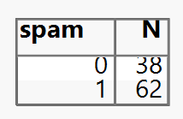
Data Collection
Sample
Source Data Set
Spambase (1999)
Sample of 4601 observations of spam/ non-spam classifications
57 continuous variables, 1 nominal class variable
Assessment Data Set
Obtained more recent sample of spam and non spam emails to assess relevancy of original predictors on current emails
Spamassassin (2005)
Spambase Data Set- Lichman, M. (2013). UCI Machine Learning Repository [http://archive.ics.uci.edu/ml]. Irvine, CA: University of California, School of Information and Computer Science. https://archive.ics.uci.edu/ml/datasets/spambase
Spamassassin- http://svn.apache.org/repos/asf/spamassassin/trunk/CREDITS

Slide 5
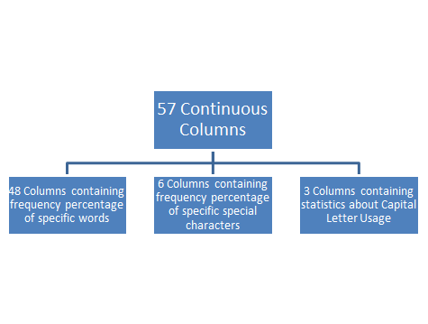

Data Overview
Explore

Slide 6
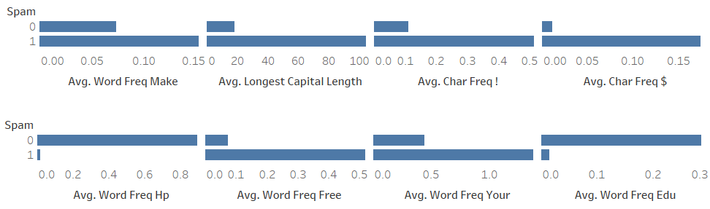
Visual Data Exploration
Explore
Features that have a significant difference in the average word frequency between spam and non-spam mails would be important predictors, regardless of the model used. Example: ‘$’, ‘edu’

Slide 7
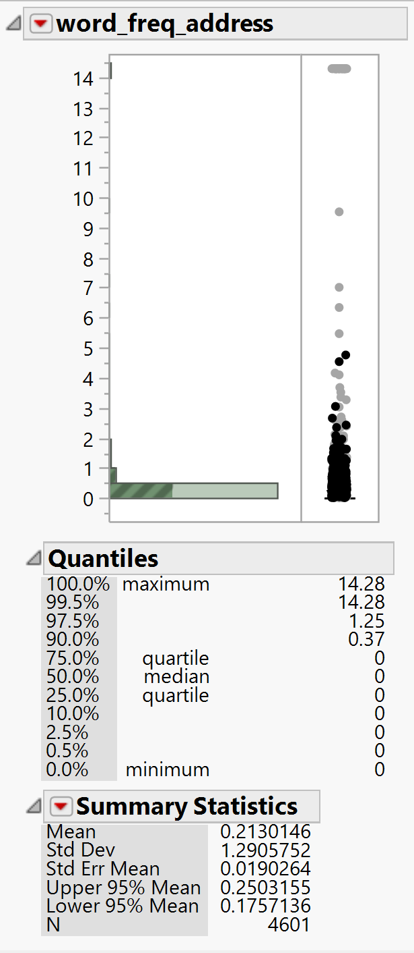
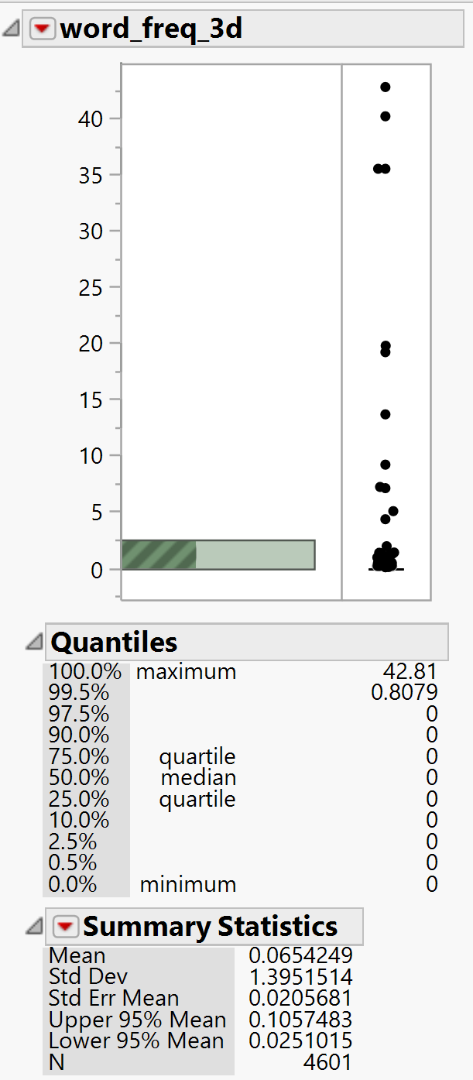
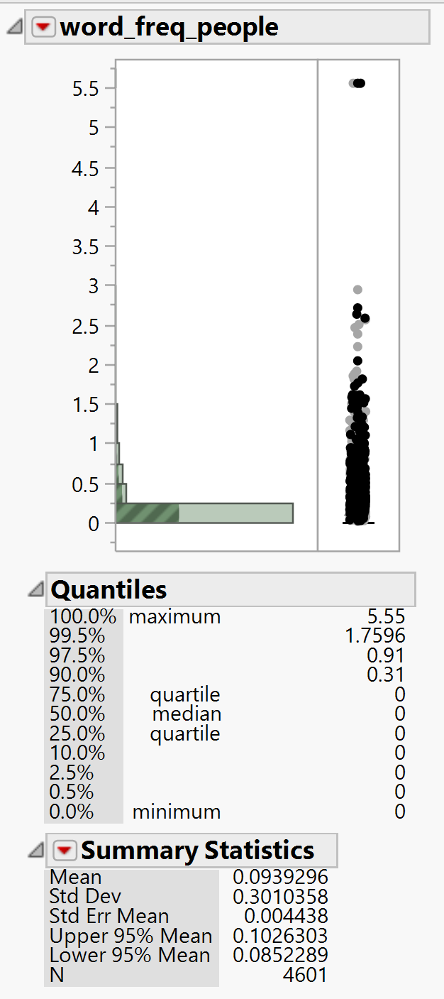
Handling Outliers
Modify
The black dots indicate the spam mail observations and the grey dots indicate non-spam observations

Slide 8
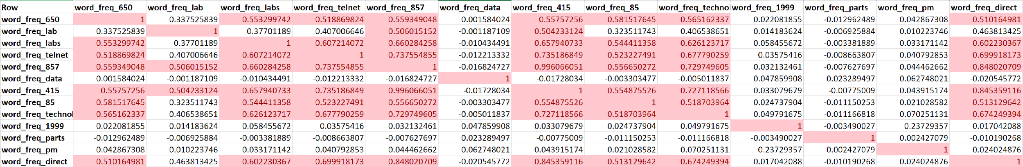
Collinearity
Modify
Notes:
collinearity

Slide 9
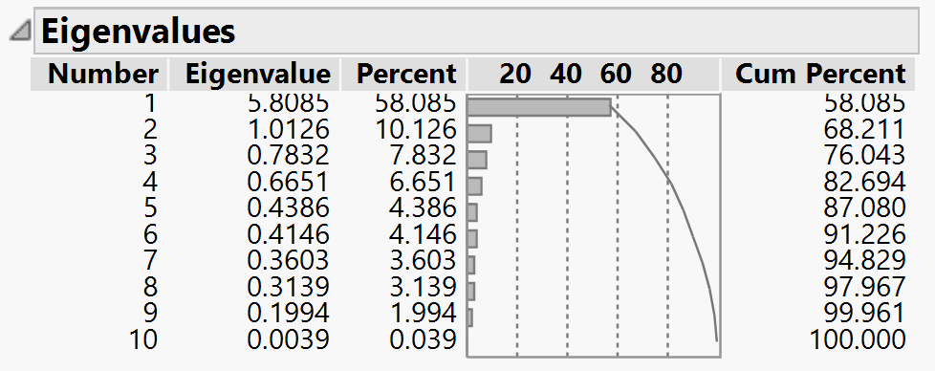
Principal Component Analysis
Modify
Out of 57 variables, only 10 variables have a linear correlation between them.
word_freq_650
word_freq_lab
word_freq_labs
word_freq_telnet
word_freq_857
word_freq_415
word_freq_85
word_freq_technology
word_freq_direct
word_freq_cs
When PCA was performed on them, no significant reduction was observed.

Slide 10
Why Asymmetric Misclassification Rate?
Modify
False Positives
70%
2
Actual Misclassification
5%
Asymmetric Misclassification
7.76%
False Negatives
30%
0.5

Slide 11
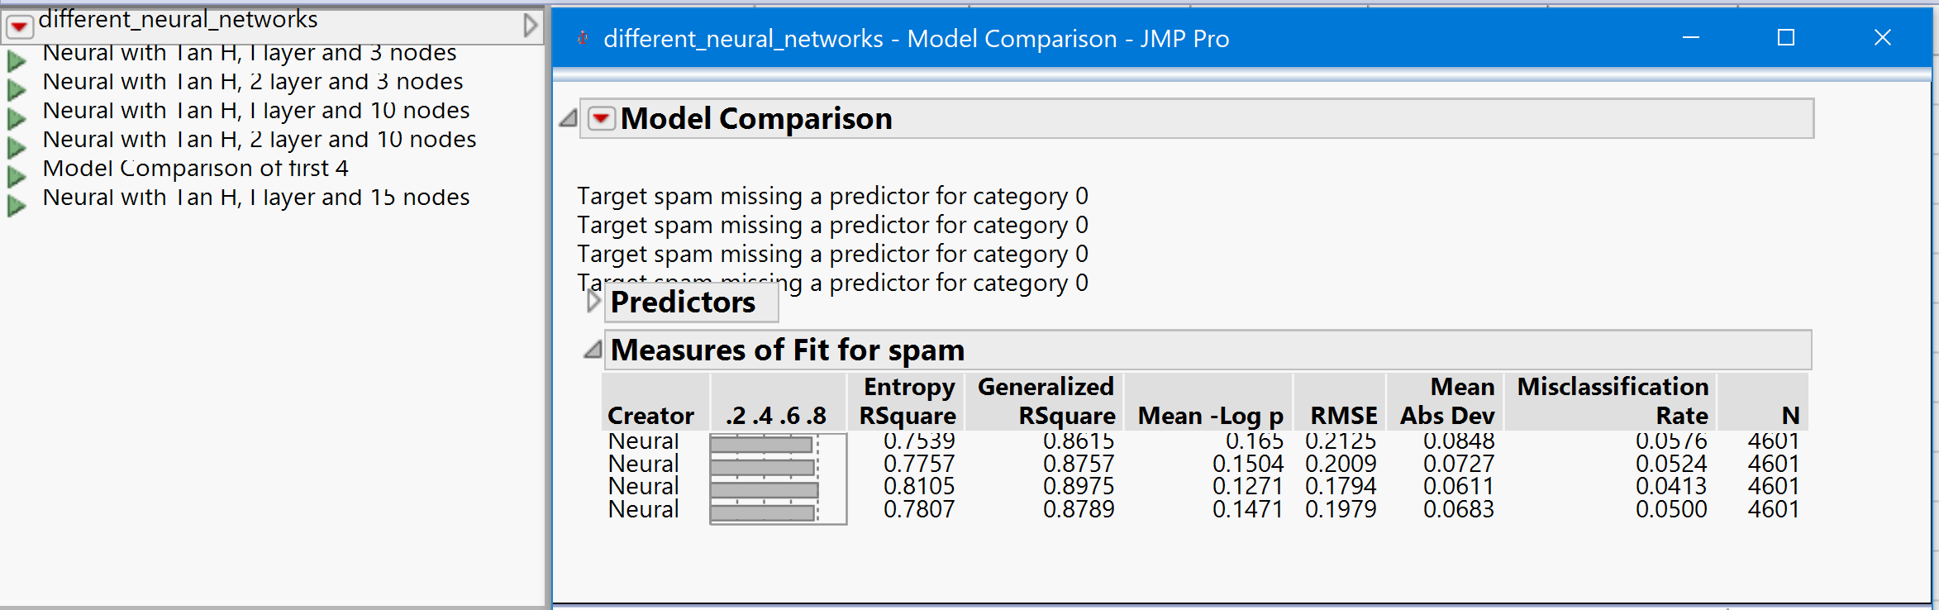
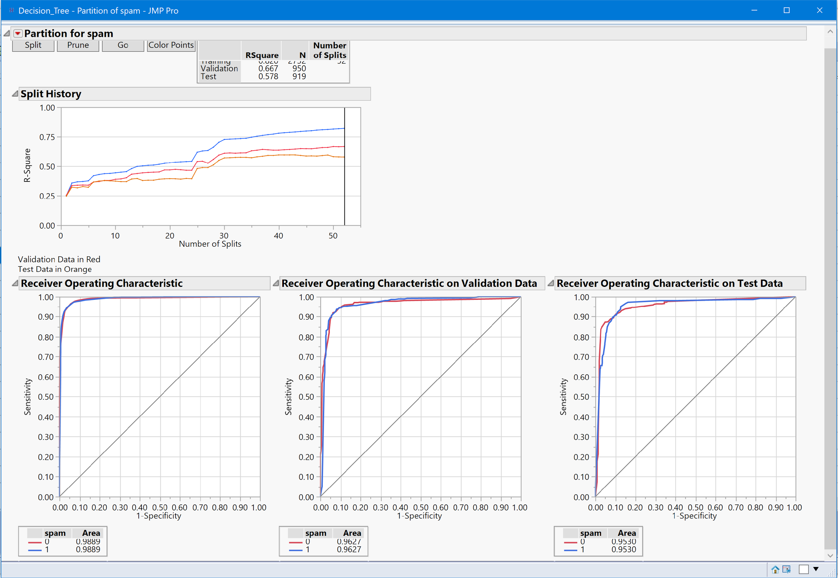
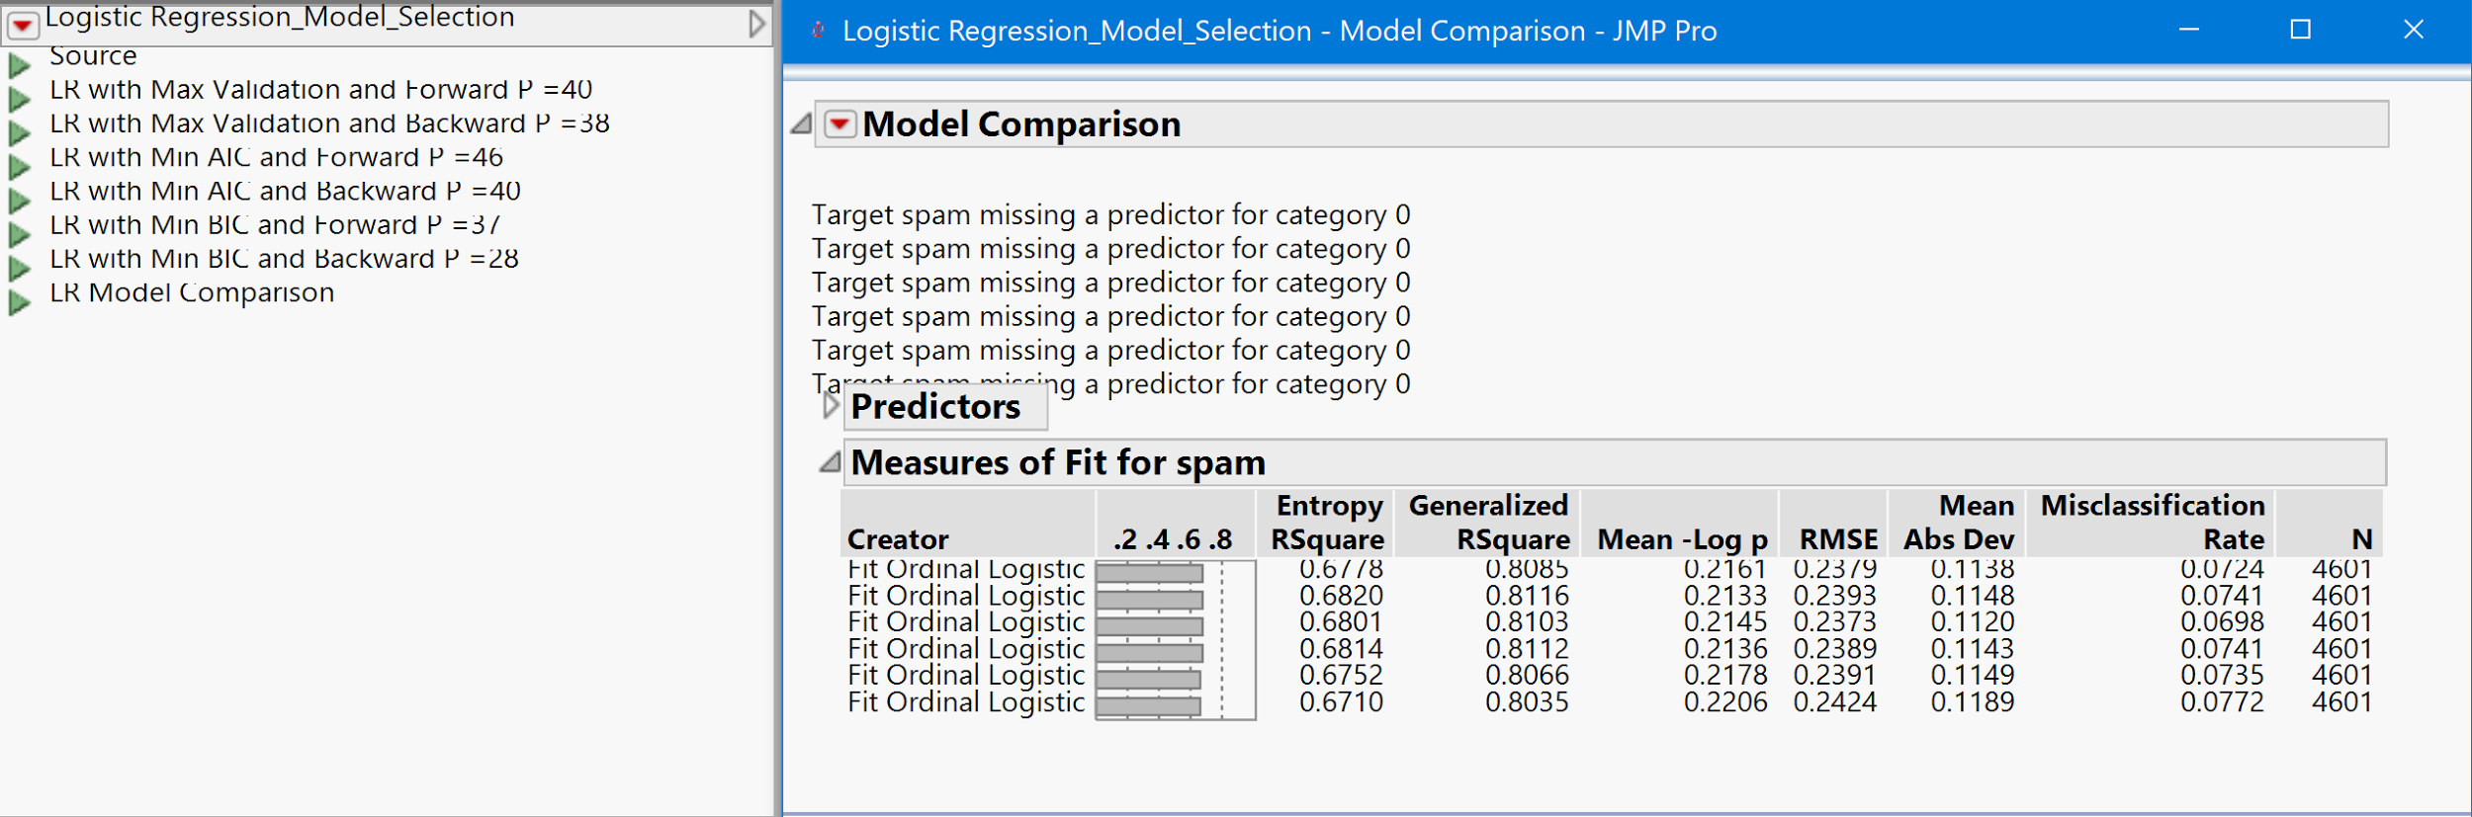
JMP Models
Model

Slide 12
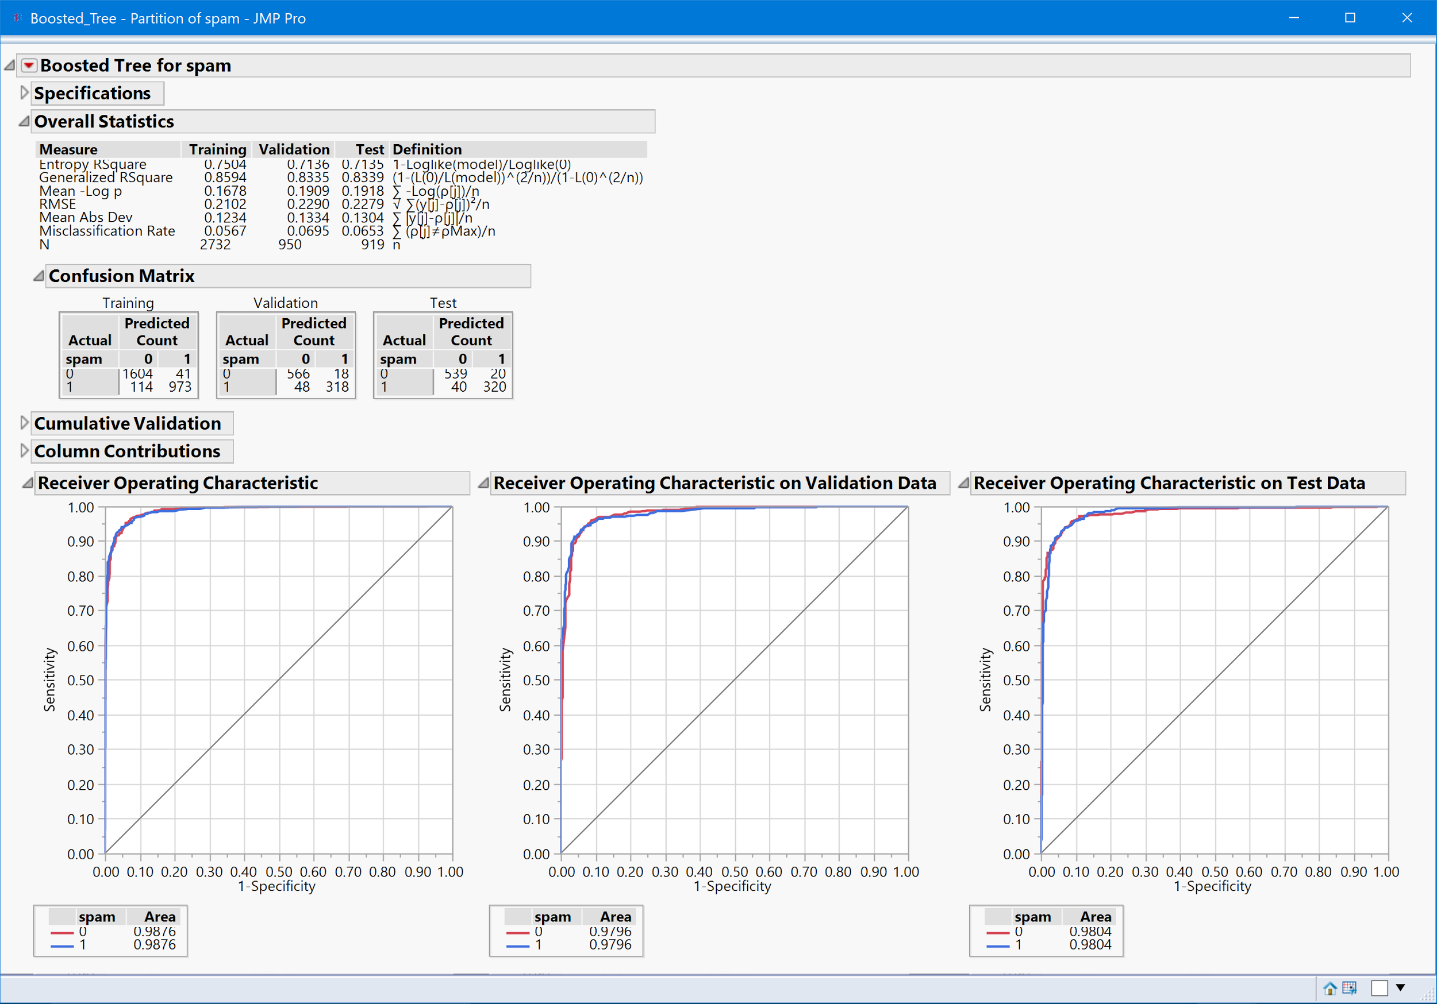
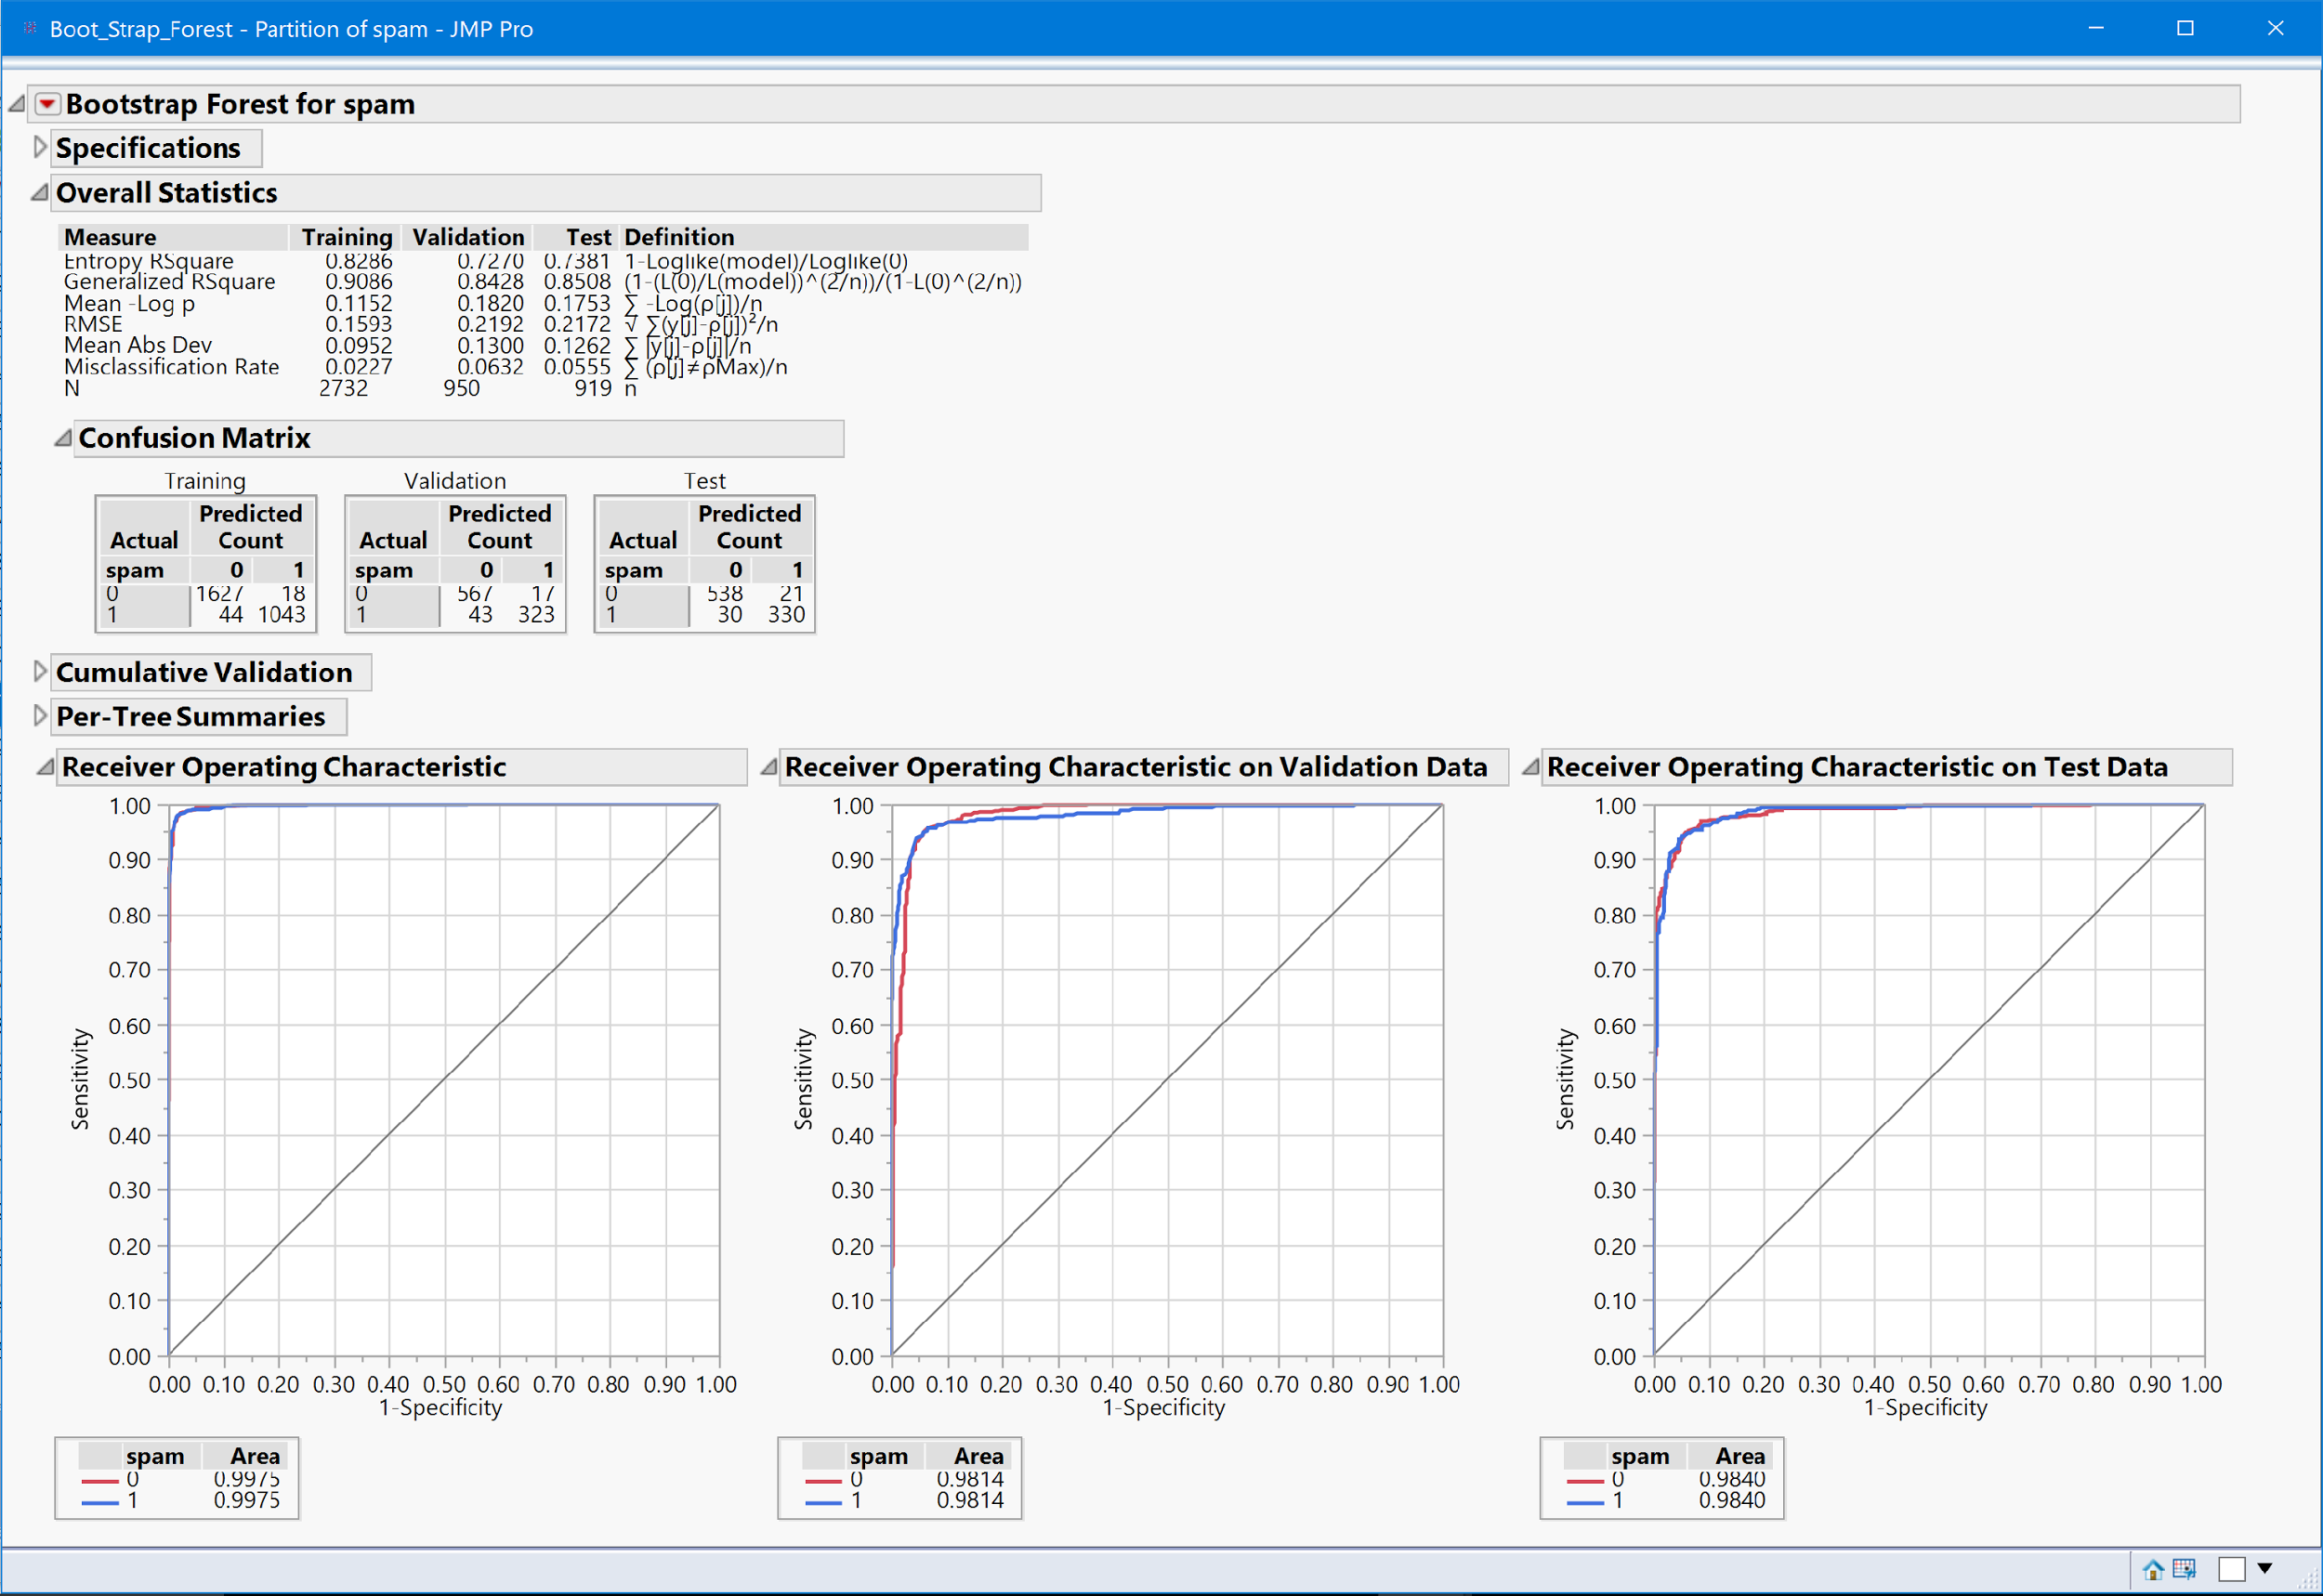
JMP Models
Model

Slide 13
JMP Models
Model
Model | Training ROC | Validation ROC | Test ROC | Training RMSE | Validation RMSE | Test RMSE | Training MR | Validation MR | Test MR | Asymmetric Cost | Asymmetric Proportion
Boosted Tree | 0.987 | 0.979 | 0.98 | 0.21 | 0.229 | 0.228 | 0.056 | 0.069 | 0.065 | 99.2 | 2.16%
Bootstrap Forest | 0.997 | 0.9814 | 0.984 | 0.1593 | 0.219 | 0.217 | 0.022 | 0.063 | 0.055 | 67.7 | 1.47%
Decision Tree | 0.988 | 0.9627 | 0.953 | 0.1819 | 0.2403 | 0.2742 | 0.043 | 0.074 | 0.093 | 159.9 | 3.48%
LR Model | 0.9781 | 0.9749 | 0.9639 | 0.2321 | 0.2385 | 0.2603 | 0.068 | 0.075 | 0.088 | 167.3 | 3.64%
Neural with VS | 0.984 | 0.976 | 0.9747 | 0.209 | 0.2267 | 0.2366 | 0.054 | 0.061 | 0.0674 | 142.6 | 3.10%
Neural with all Variables | 0.9872 | 0.9746 | 0.971 | 0.1965 | 0.2312 | 0.2321 | 0.049 | 0.068 | 0.065 | 100 | 2.17%

Slide 14
R Models
Model
Model | Training ROC | Validation ROC | Training AMR | Validation AMR | Overall AMR | 10 Cross Validation Set AMR
LR Model with Backward Stepwise minimizing AIC | 0.9544165 | 0.9510358 | 3.71% | 3.32% | 3.61%
Classification Tree | 0.9166601 | 0.8926511 | 4.85% | 5.16% | 4.93%
Random Forest | 0.999621 | 0.9930463 | 0.08% | 1.76% | 0.26% | 4.00%
Boosted Tree | 0.9947542 | 0.9834856 | 1.15% | 2.08% | 1.44% | 4.10%
AMR -> Asymmetric Misclassification Rate

Slide 15
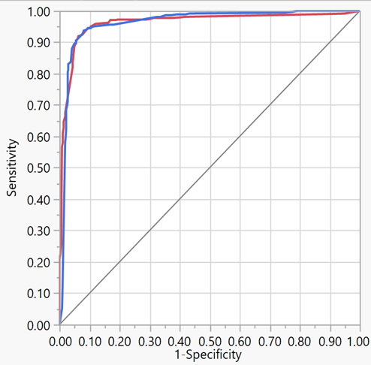
Selection Criteria
Assess
Predicted | Actual
 | 0 | 1
0 | 2773 | 77*0.5
1 | 15*2 | 1736
Asymmetric Misclassification Rate
AMR = (77*0.5+15*2) / 4601
AMR = 1.5%
While Actual
Misclassification Rate = 77 +15 /4601
MR = 2%
AREA UNDER THE CURVE

Slide 16
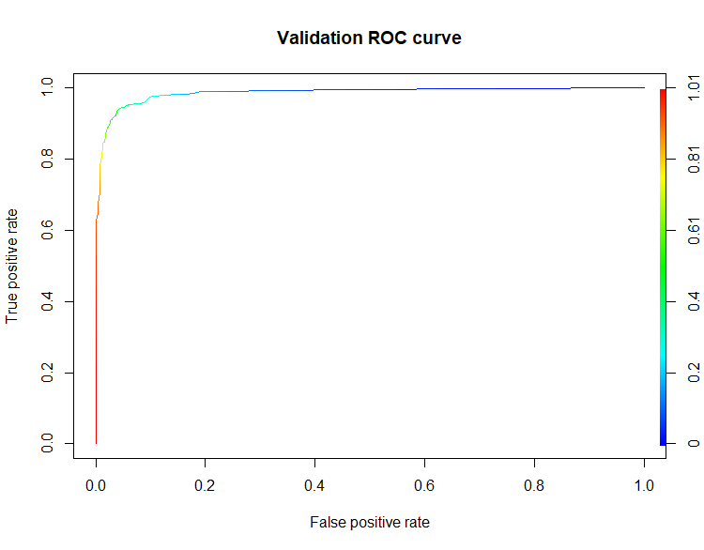
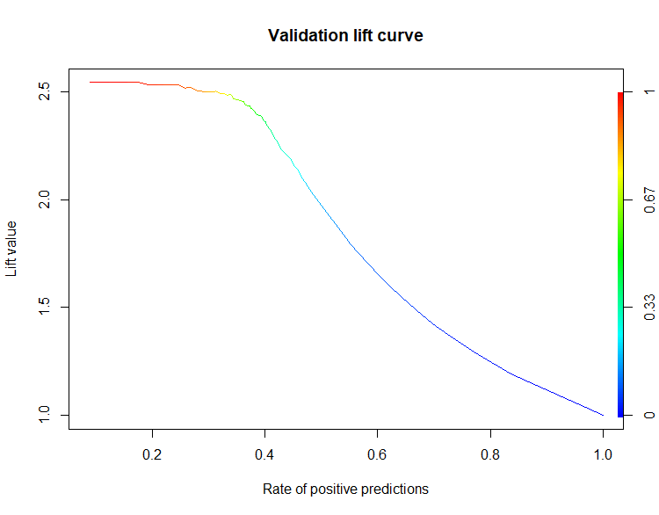
ROC AND LIFT CURVES
Assess
Validation Data ROC Curve
Validation Data Lift Curve

Slide 17
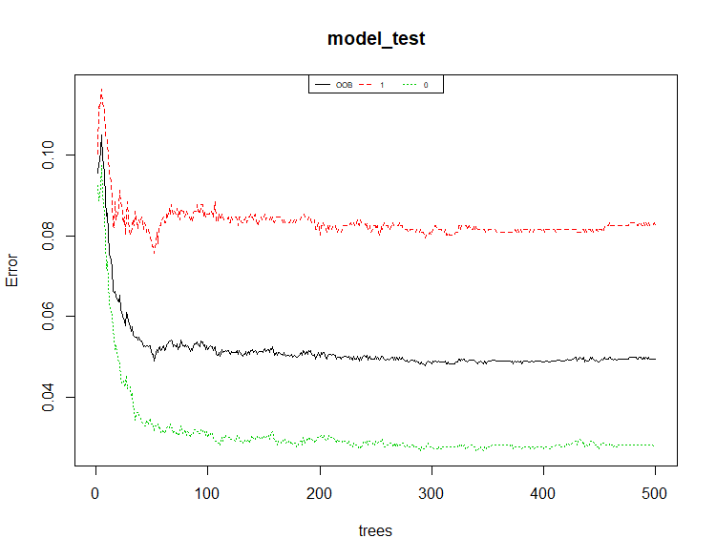
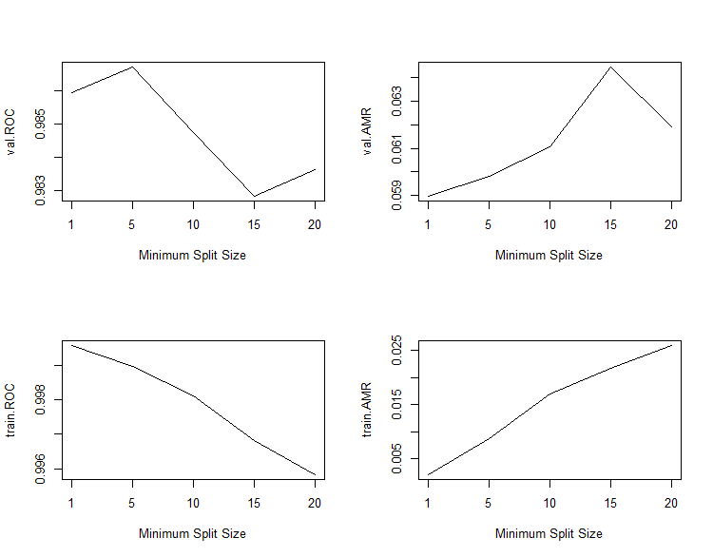
Random Forest Parameters
Assess
Total Number of Trees
Minimum size of Terminal Nodes

Slide 18
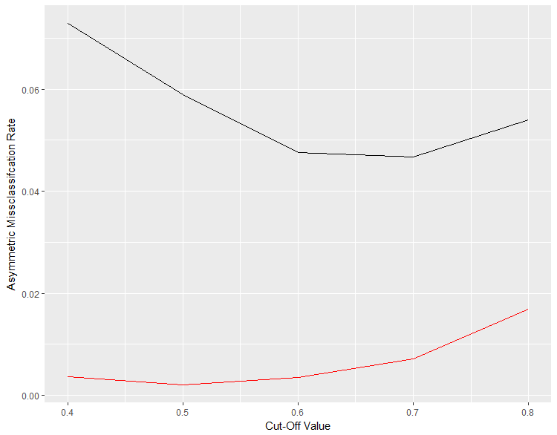
Cut-off Value Selection
Assess
Validation
Training

Slide 19
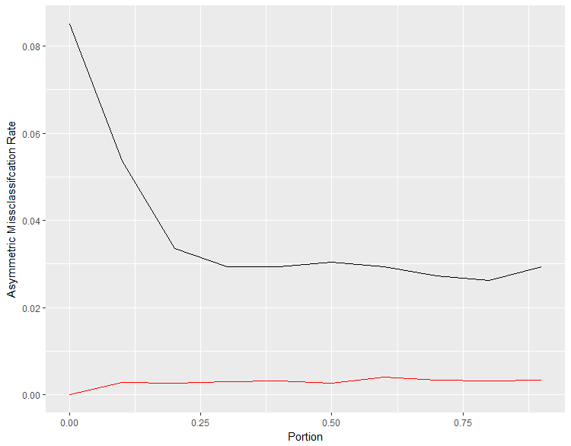
Learning Curve
Assess
Validation
Training

Slide 20
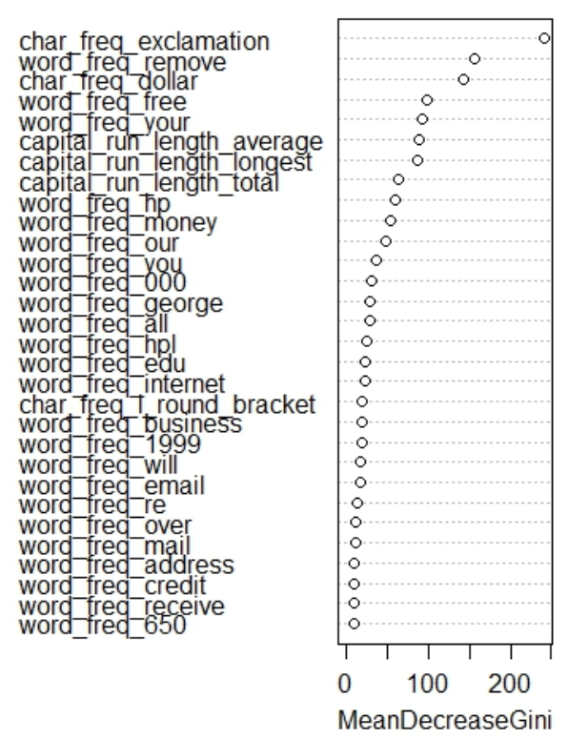
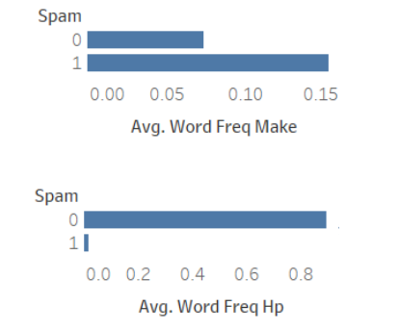
Variable Importance
Assess

Slide 21
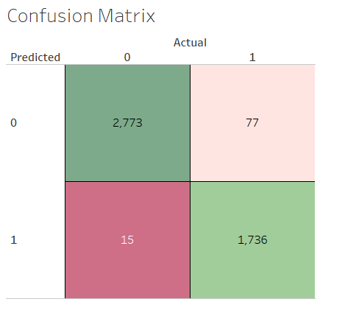
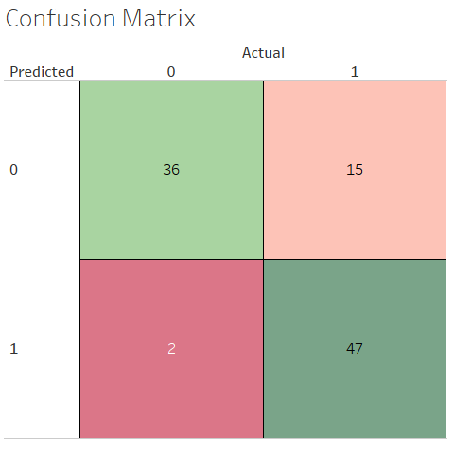
Confusion Matrix
Assess
Performance on complete data from 1999
Performance on complete data from 2005

Slide 22




Key Findings and Implications
Improved Open Rate
Personalization helps
Cost Reduction
Relevance in today’s world
Words to avoid/include in commercial marketing emails
Usage of name, organization or address, increases the probability of being classified as a non-spam
Working time loss - approximately 1,200 minutes per employee per year
Recall model performance on recent assessment data
Notes:
1) Cost reduction - majority of spam costs stem from employees who spend working time identifying and deleting spam. The working time losses caused by spam are approximately 1,200 minutes per employee per year; these costs could be reduced by roughly 35% through the installation of a spam filter mechanism. The individual efficiency of a spam filter installation depends on the amount of spam that is received and on the level of knowledge about spam.
2) Use in marketing to increase open rate- increase effectiveness of email campaigns
3) model can be used to classify in current – from assessment of new data
4) Show example of “George” and “hp”
4)

Slide 23

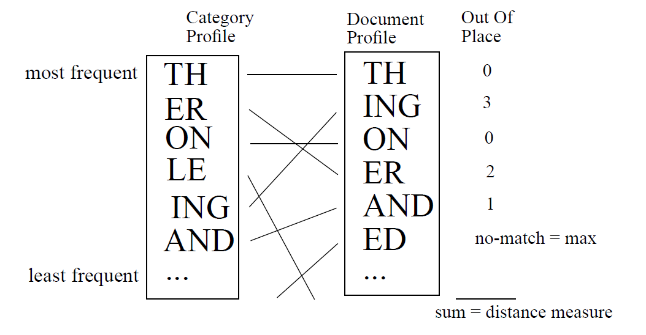
Future Works
Handling picture-based spams:
Attaching an OCR module before the prediction model would help in identifying picture-based spams containing a single picture with embedded URLs
Word combinations:
Using N-gram algorithm, train the model with a data that contains the combination of word occurrences, to enhance classification

Slide 24
Questions?

